Slide 1
Exploring the Role of Europe in the global LNG Market Equilibrium until 2040
Sebastian Zwickl-Bernhard^{1,2}, Antonia Golab², Hans Auer^{1,2}
¹Energy Economics Group (EEG), Technische Universität Wien
²Department of Industrial Economics and Technology Management, The Norwegian University of Science and Technology (NTNU), Trondheim, Norway
13. Internationale Energiewirtschaftstagung an der TU Wien / 15. – 17. Februar 2023 „Die Zukunft der Energiemärkte in Europa vor dem Hintergrund neuer geopolitischer Ungleichgewichte“
Corresponding author/Presenter: zwickl@eeg.tuwien.ac.at

Slide 2
Motivation and Background
The world is committed to achieving carbon neutrality by mid-century
Increasing shares of renewable energy in the energy system replace fossil energy sources
However, the speed on the way and the specific target year in which net zero emissions are emitted vary between regions
Europe aims to achieve carbon neutrality in 2050
While China has defined 2060 as the target year
Transitional solutions and so-called bridge technologies (or bridge fuels) are necessary if renewable energy cannot fully supply the energy system
A pillar of these bridge technologies, namely liquefied natural gas (LNG), is the subject of this work

Slide 3
The role of LNG in energy systems
LNG’s role has differed significantly among global regions
Traditionally, the Asian market, particularly the Japanese one, firmly focused on LNG
Today, as China has become the largest LNG importer worldwide, more than half of China's overall natural gas imports are LNG
On the contrary, LNG imports to Europe were minor since Europe has been supplied with piped gas in the last decades.
Collapse of Russian piped gas imports to Europe in 2022 has led to a rethinking of natural gas in Europe
Measures were taken to reduce energy and, thus, gas consumption
On the other hand, Europe had to look for alternatives to replace the lack of imports from Russia
In addition to (limited) increased piped gas imports from Norway and other reactions, the main consequence is that LNG is on Europe's agenda now
Notes:
I start this presentation with a brief overview of the European heating sector. So far, fossil-fuel based heat generation dominates the supply of heat service needs. The share of renewable energy in the provision of heating and cooling services is only just above 20% on average in all EU member states. In Austria, it is 34%. However, fossil fuels continue to dominant here as well. To be more precise, 1.4 million dwellings are heated with natural gas or oil in Austria today. Switching these heating systems to renewable energy by 2050, retrofitting 50 thousand end-user devices per year or more than 130 per day becomes necessary. To achieve this goal, we need not only sustainable decentralized heating systems, but also a massive expansion of centralized heating and cooling networks. In particular, district heating networks will play a crucial role as they (i) ensure a highly efficient usage of renewable heat sources, such as biomass/waste and hydrogen; (ii) give us the opportunity to achieve significant retrofitting rates by high connection rates; and (iii) can unburden the electricity sector as we expect high electrification rates of different energy service needs, such as in the transport and industry sector.

Slide 4
LNG is essential for Europe‘s energy supply security (Short-term)
That is why Europe was willing to pay high prices in 2022, facing the risk of not being able to meet all the natural gas demands otherwise
In order to bring the procured quantities of LNG to Europe and the countries, new LNG terminals across Europe were also built (e.g., Germany, Poland, but also Italy and Greece have already built or are currently in the process to built LNG terminals)
In view of the above, it can be expected that LNG will play an important role in Europe's energy supply not only in the crisis mode of 2022, but also in the medium term.
Although European countries have attempted to negotiate short-term supply contracts for LNG, the investments made in LNG terminals and related transport infrastructure point to longer-term planning
(i) how far LNG can contribute to the achievement of European and global climate targets and what quantities will be demanded regionally; (ii) there is also the significant issue of how a market equilibrium for LNG will develop in the medium to long term (2022’s market situation not representative for future market equilibrium)
Notes:
I start this presentation with a brief overview of the European heating sector. So far, fossil-fuel based heat generation dominates the supply of heat service needs. The share of renewable energy in the provision of heating and cooling services is only just above 20% on average in all EU member states. In Austria, it is 34%. However, fossil fuels continue to dominant here as well. To be more precise, 1.4 million dwellings are heated with natural gas or oil in Austria today. Switching these heating systems to renewable energy by 2050, retrofitting 50 thousand end-user devices per year or more than 130 per day becomes necessary. To achieve this goal, we need not only sustainable decentralized heating systems, but also a massive expansion of centralized heating and cooling networks. In particular, district heating networks will play a crucial role as they (i) ensure a highly efficient usage of renewable heat sources, such as biomass/waste and hydrogen; (ii) give us the opportunity to achieve significant retrofitting rates by high connection rates; and (iii) can unburden the electricity sector as we expect high electrification rates of different energy service needs, such as in the transport and industry sector.

Slide 5
Core objective
Investigating the global LNG market equilibrium until 2040
Thereby, exchanged LNG quantities between the most relevant import and export countries to meet expected demands and resulting regional LNG prices are in the foreground of the analysis
We focus on the European market and its most relevant export countries to cover Europe's demand until 2040
The analysis furthermore allows estimating future LNG price developments until 2040
LNG prices are often needed for modeling energy systems and are, in those predominantly, an exogenous input parameter.
Present values for LNG price trends, especially for those in Europe considering the absence of Russian pipeline gas, may therefore be of great importance for future work of the scientific community analyzing the trajectory of Europe toward carbon neutrality.
Notes:
Against this background, the core objective of this work is the downscaling of decarbonization scenarios of the heating sector, taking into account the infrastructure/network requirements of heat generation technologies/sources, from the country to the community level. In particular, the prioritized preference of heat sources in centralized heat networks plays a crucial role, ensuring highly efficient usage of heat sources. Moreover, the assessment of centralized or district heating networks using heat density as a criterion is important in this analysis. We conduct an Austrian case study, downscaling cost-minimizing heat generation portfolios 2050, obtained from the large numerical energy system model GENeSYS-MOD, from the country to the grid level.

Slide 6
Methodology
Development of a linear optimization model
The objective function is to minimize the total LNG import costs (i.e., the sum of all import countries) while fulfilling all importer's exogenously predefined LNG demands
Import and export countries are represented by nodes in the model
Optimality of the model finds, among others, optimal LNG flows from each export to each import country
Input parameters encompass LNG import volumes (i.e., demands) with a monthly or yearly resolution, LNG export capacities, and LNG break-even prices
Additionally, spatial and further techno-economic data is used to calculate LNG transportation between each export and each import country
Notes:
Against this background, the core objective of this work is the downscaling of decarbonization scenarios of the heating sector, taking into account the infrastructure/network requirements of heat generation technologies/sources, from the country to the community level. In particular, the prioritized preference of heat sources in centralized heat networks plays a crucial role, ensuring highly efficient usage of heat sources. Moreover, the assessment of centralized or district heating networks using heat density as a criterion is important in this analysis. We conduct an Austrian case study, downscaling cost-minimizing heat generation portfolios 2050, obtained from the large numerical energy system model GENeSYS-MOD, from the country to the grid level.

Slide 7
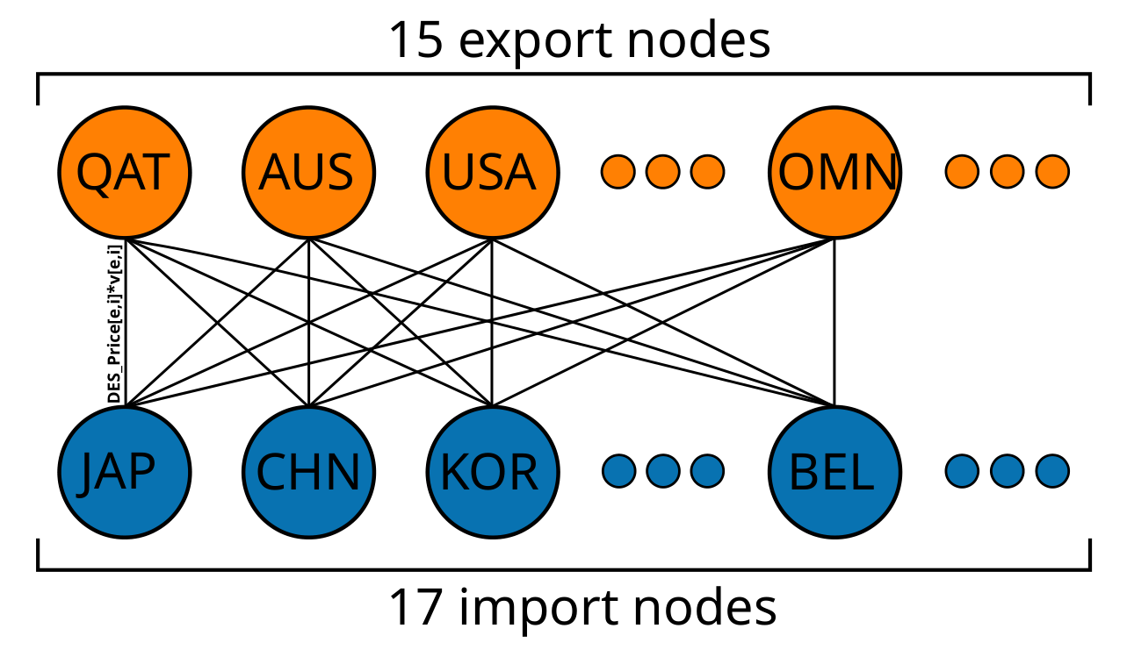
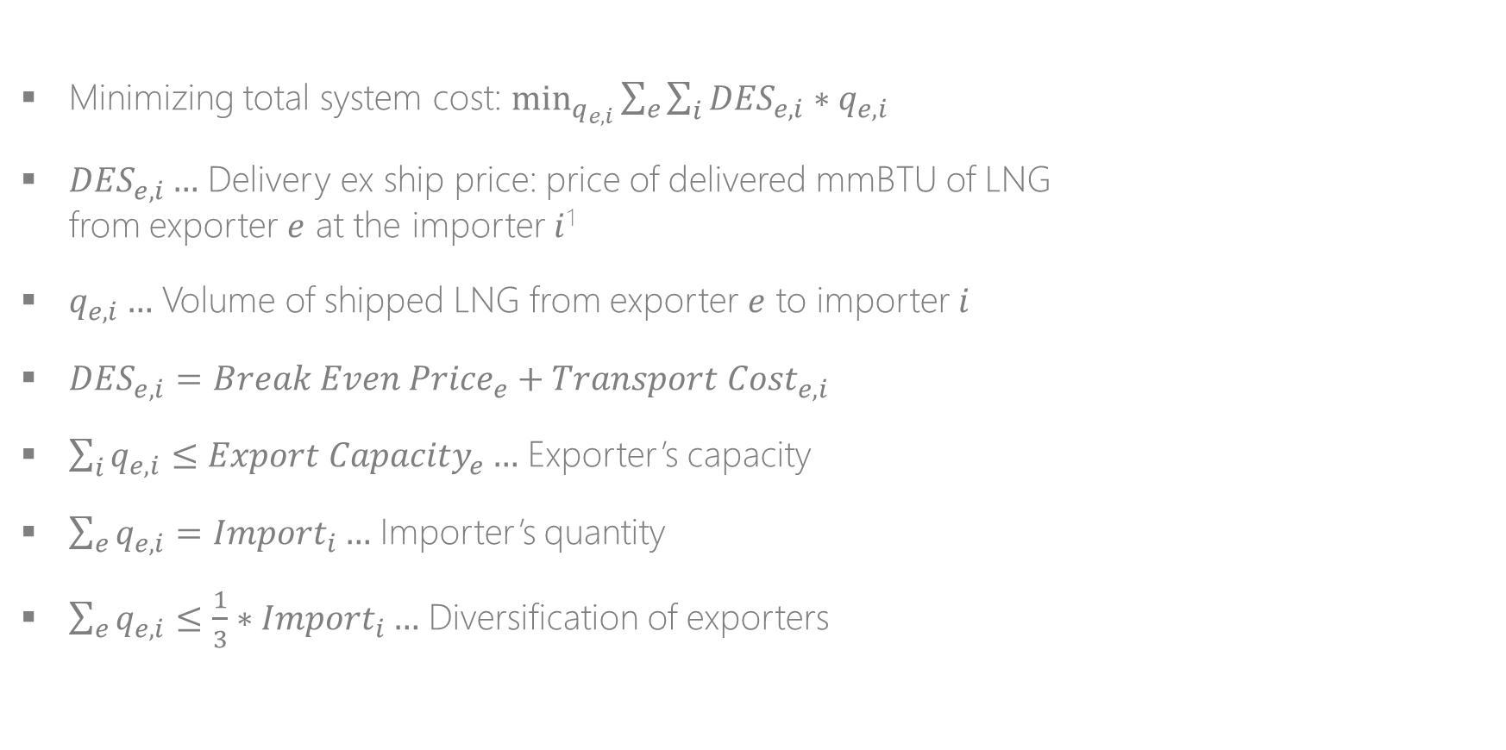
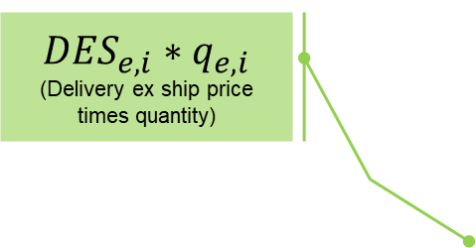
Overview of the model
$${DES}_{e,i}∗q_{e,i}$$
(Delivery ex ship price times quantity)
(e)
Minimizing total system cost: $\min_{q_{e,i}}{\sum_{e}{\sum_{i}{{DES}_{e,i}∗q_{e,i}}}}$
${DES}_{e,i}…$ Delivery ex ship price: price of delivered mmBTU of LNG from exporter $e$ at the importer $i$¹
$q_{e,i}…$ Volume of shipped LNG from exporter $e$ to importer $i$
${DES}_{e,i}={Break Even Price}_{e}+{Transport Cost}_{e,i}$
$\sum_{i}{q_{e,i}≤{Export Capacity}_{e}}…$ Exporter’s capacity
$\sum_{e}{q_{e,i}={Import}_{i}}…$ Importer’s quantity
$\sum_{e}{q_{e,i}≤{\frac{1}{3}∗Import}_{i}}…$ Diversification of exporters
(i)
LNG Break Even Price = feed gas + Capex of liquefaction facilitates + royalties and taxes
¹The exporter carries the obligation and cost of transportation.
Notes:
Against this background, the core objective of this work is the downscaling of decarbonization scenarios of the heating sector, taking into account the infrastructure/network requirements of heat generation technologies/sources, from the country to the community level. In particular, the prioritized preference of heat sources in centralized heat networks plays a crucial role, ensuring highly efficient usage of heat sources. Moreover, the assessment of centralized or district heating networks using heat density as a criterion is important in this analysis. We conduct an Austrian case study, downscaling cost-minimizing heat generation portfolios 2050, obtained from the large numerical energy system model GENeSYS-MOD, from the country to the grid level.

Slide 8
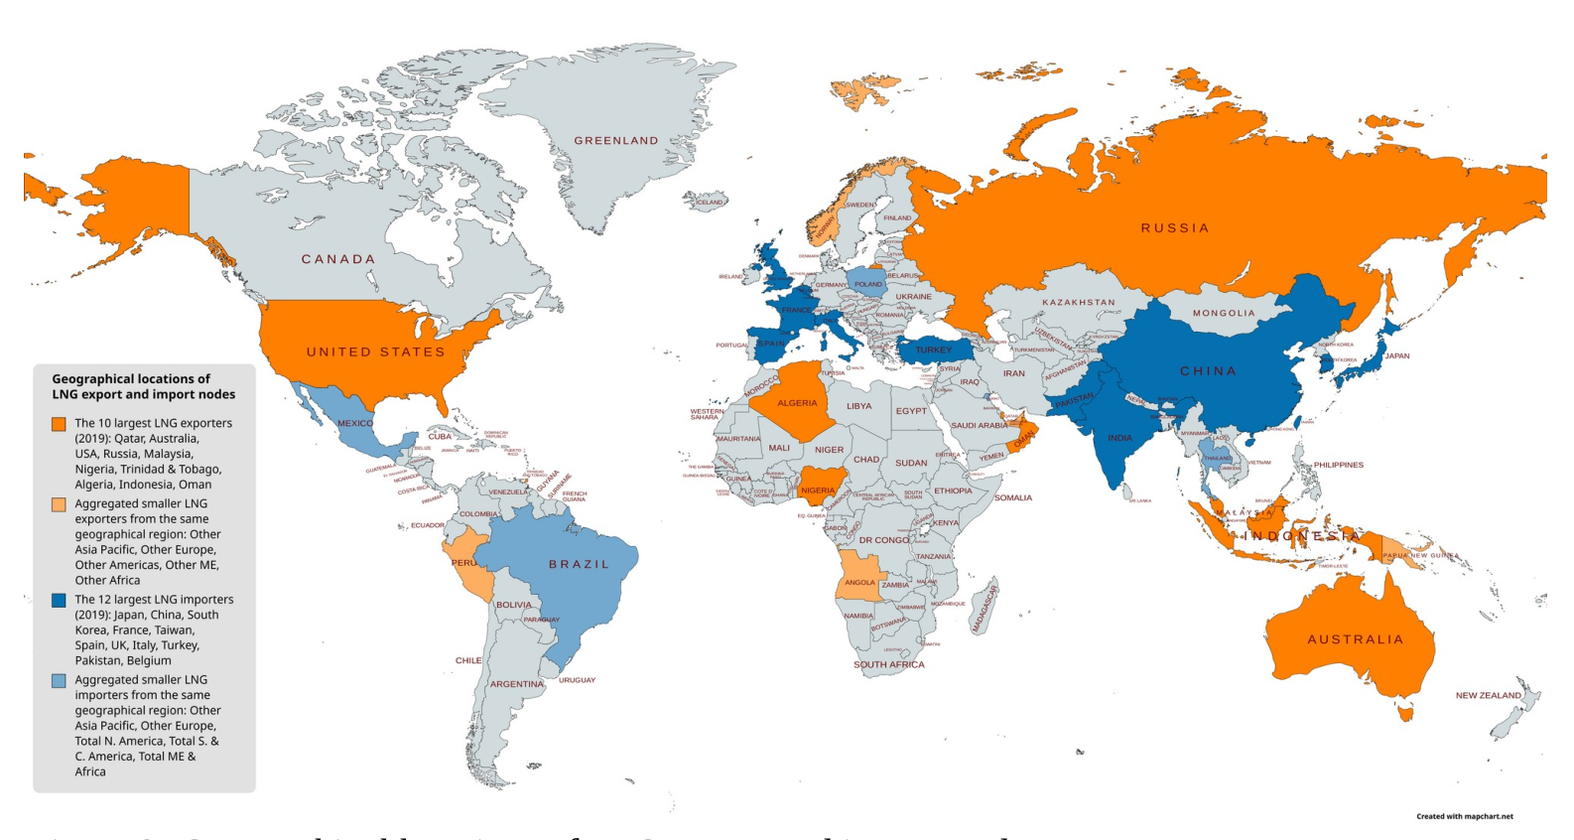
Geographical locations of LNG export and import nodes (2019)
Notes:
Against this background, the core objective of this work is the downscaling of decarbonization scenarios of the heating sector, taking into account the infrastructure/network requirements of heat generation technologies/sources, from the country to the community level. In particular, the prioritized preference of heat sources in centralized heat networks plays a crucial role, ensuring highly efficient usage of heat sources. Moreover, the assessment of centralized or district heating networks using heat density as a criterion is important in this analysis. We conduct an Austrian case study, downscaling cost-minimizing heat generation portfolios 2050, obtained from the large numerical energy system model GENeSYS-MOD, from the country to the grid level.

Slide 9
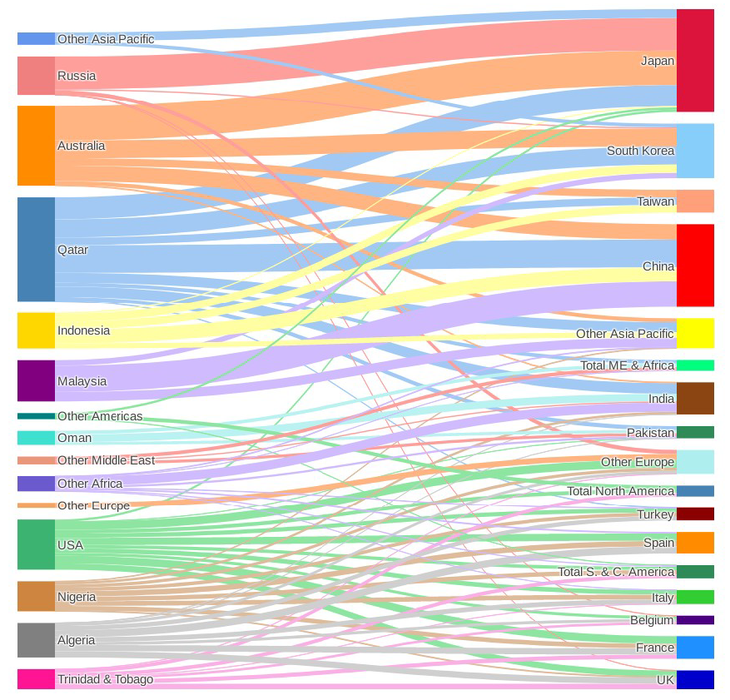
Global LNG market in 2019 (validation of the model)
Determined LNG flows confirm the clear perspective of the geographical division of the global LNG market into three regions (valid for importers and exporters) (A) Atlantic Basin (B) Pacific Basin (C) Middle East
Japan, China and South Korea are mainly supplied by Australia, Indonesia and Malaysia (➔ Pacific Basin)
Qatar: (1) largest LNG exporter; (2) lowest “Break Even Price”; (3) mainly serving the Asian market
USA, Algeria and Nigeria are the main exporters for Europe‘s LNG demand in 2019

Slide 10
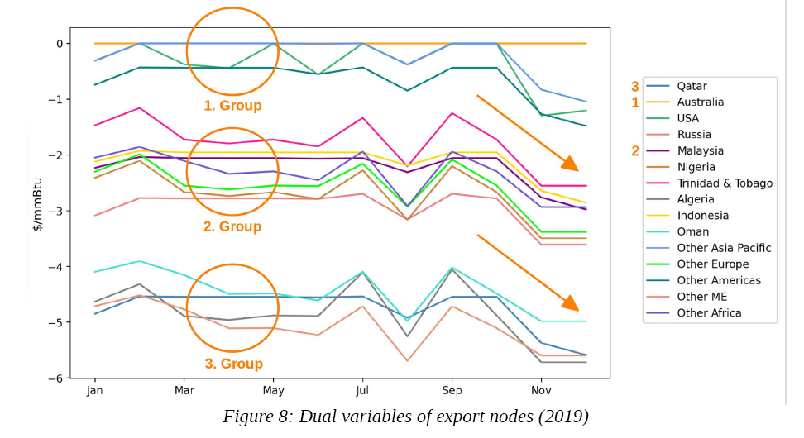
Value of increasing liquefaction capacities of exporters (2019)
➔ Quantification of the change in exporter’s liquefaction capacities on the total cost
Intention to use long-term contracts to protect Group 1 exporters from unfavorable developments in the LNG market
1. Group: Nodes with no or minimal potential for reducing cost (e.g., Australia and USA)
2. Group: Nodes with moderate potential for reducing cost (e.g., Indonesia, Malaysia, and European countries)
3. Group: Nodes with strong potential for reducing cost (e.g., Qatar, Algeria)
Fig: Shadow price of exporters
Characteristic seasonality of gas market and limited LNG storage capacities (e.g., China)

Slide 11
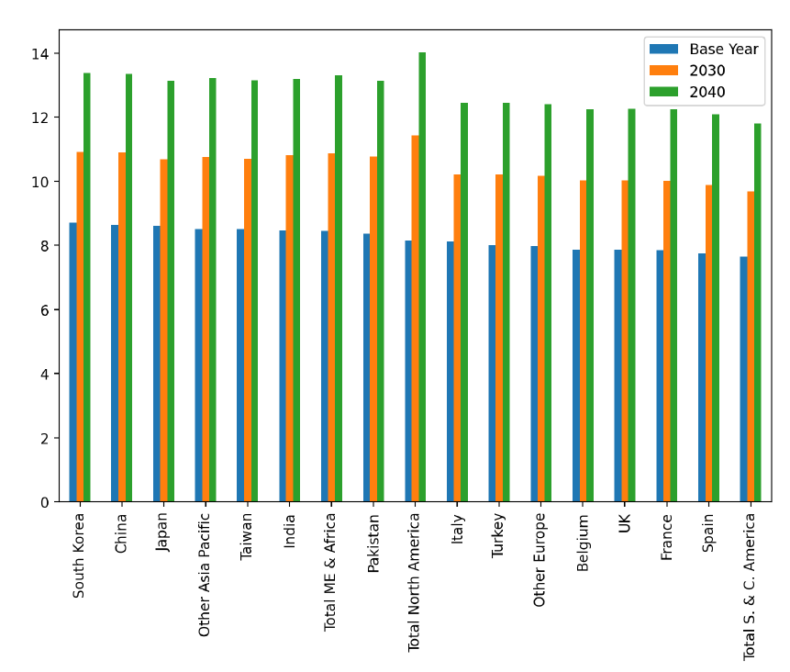
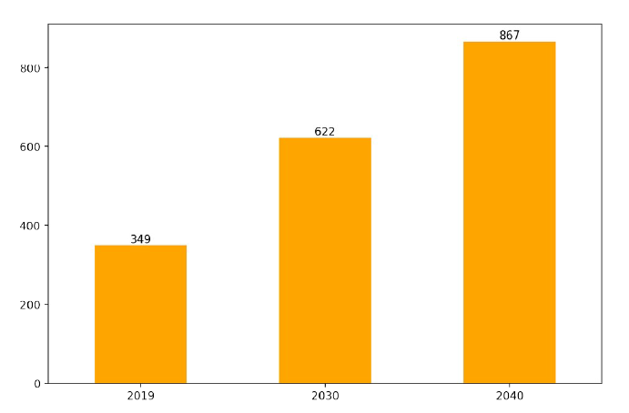
Global LNG market development until 2040
Fig: Weighted DES prices of importers until 2040 in $ per mmBTU
Assumption: Steady growth of global LNG trade
Floating Storage and Re-Gasification Units (FSRU) with low CAPEX
“LNG to power” possibility with FSRU
Much shorter time for realization
2019 2030 2040
2019 2030 2040
Geographical trend of LNG market prices in 2040 remain relatively the same compared to 2019
+ 150%
Fig: Number of LNG carriers in 2019, 2030, and 2040

Slide 12
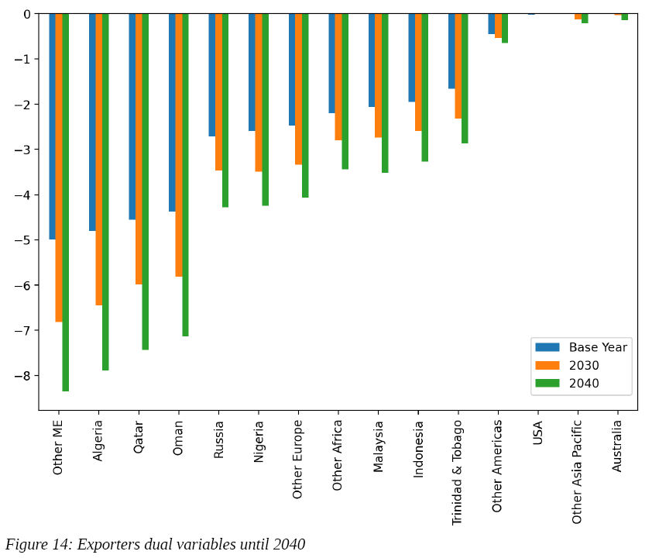
Value of increasing liquefaction capacities of exporters (2040)
Fig: Shadow price in $ per mmBTU
USA as exporter with the largest LNG liquefaction capacity replaces Australia as a marginal exporter in 2040 compared to 2019.
2019 2030 2040
2019 2030 2040
In 2040, results indicate the same division of exporters into the aforementioned three groups as in 2019

Slide 13
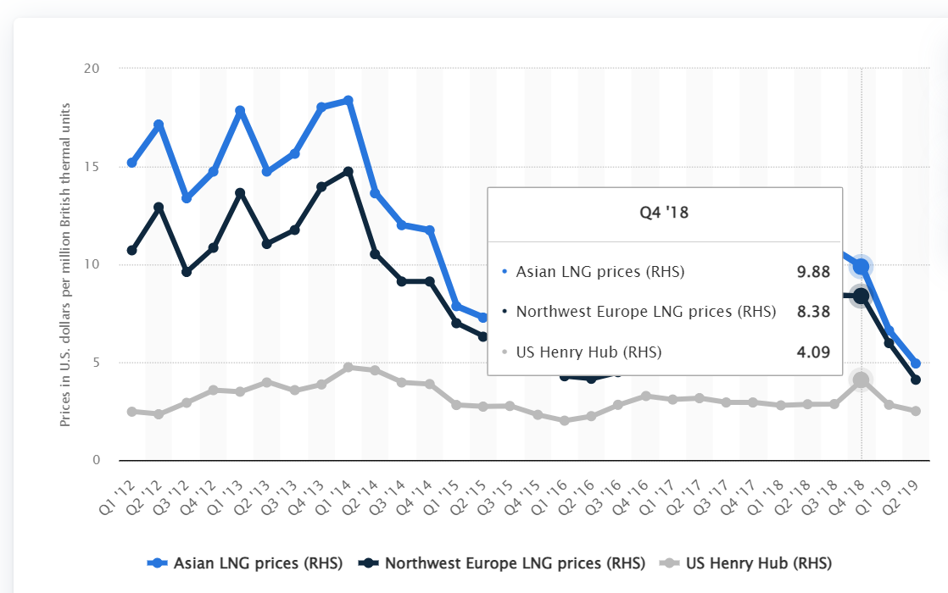
Europe’s LNG prices until 2040
8,38 and 5.97 $ per mmBTU in Q4 2018 and Q1 2019
Country / in $ per mmBTU | 2019 | 2030 | 2040
Belgium | 7,9 | 10,0 | 12,2
Germany (and other Europe) | 7,9 | 10,0 | 12,2
France | 7,9 | 10,0 | 12,1
Italy | 8,0 | 10,0 | 12,2
Spain | 7,8 | 9,9 | 12,0
Average | 7,9 | 10,0 | 12,2
Fig: Quarterly prices of LNG from 2012 to 2019. Source: Statista
Europe’s LNG import price in 2040: 41.6 EUR per MWh

Slide 14
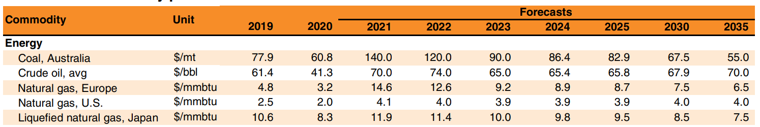
Comparison of results with previous studies
Source: Commodity Markets Outlook – Urbanization and Commodity Demand
Present results suggest higher LNG prices (about double) than in existing literature
12,2 $ per mmBTU in 2040

Slide 15
Key-Takeaways
Significant increase in the consumption of LNG expected up to 2040 due to the comparatively short start-up time and flexible use in energy systems
The trends in the geographical distribution of LNG prices remain the same in 2040 compared to historical values
In Europe, the present results indicate a rise in LNG prices to around 12,2 $ per mmBTU by 2040
Potential increase in export capacity of individual countries leads to the need for mid- and long-term supply contracts for marginal exporters (e.g., USA in 2040)

